Slide 1
Topic: Mathematical Thinking Process EQ: How do I use the mathematical thinking process to solve a problem?
Year 11 Mathematics Essentials
Mrs Parlevliet

Slide 2
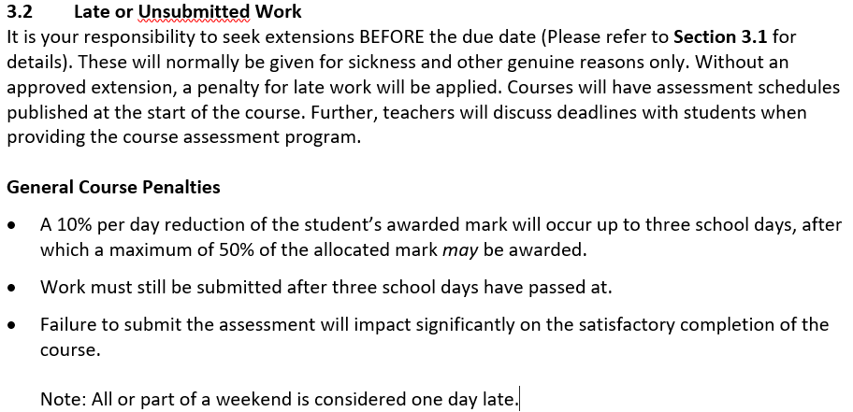
Senior School Assessment Policy

Slide 3
Mathematical Thinking Process
Today you need to work on Step 4 of the Mathematical Thinking Process so that you are prepared for Friday’s lesson when we work on the discussion and providing answers to the problem.
Remember, your Practical Application has a weighting of 10%.

Slide 4
24
7
30
Topic: Mathematical Thinking Process
Date: 03/03/2021
EQ: How do I use the mathematical thinking process to solve a problem?
What is the Mathematical Thinking Process?
The Mathematical Thinking Process is made up of the following steps:
Interpreting the Task
Identify the mathematics involved
Analyse the information and data involved which may require you to research and find the information needed
Apply mathematical knowledge and strategies to calculate values to arrive at the answer or answers to the problem
Verify the reasonableness of your answer
Communicate these findings in a suitable format
WICOR
Notes:
Required: MAB Blocks of 10s and single cubes for concrete examples

Slide 5
Task (LHS) – Apply the Mathematical Knowledge and Strategies to Calculate Values
Step 4 - Apply mathematical knowledge and strategies to calculate values to arrive at the answer or answers to the problem
Find three meals from taste.com
Research the food prices
Set up your Microsoft Excel spreadsheet to determine:
Food to buy
Budget
Anything else you can think of

Slide 6
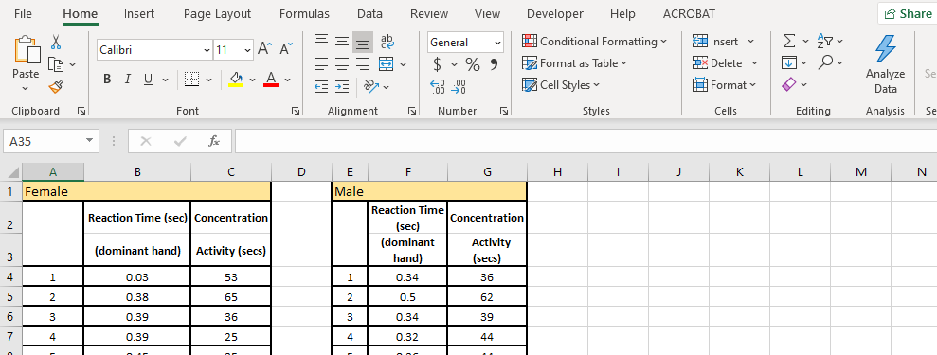
Slide 2
What is a spreadsheet?
A spreadsheet is a digital file made of rows and columns that help sort, organize, and arrange data efficiently, and calculate numerical data.
There are many versions of spreadsheets.
Microsoft Excel.
Apple Numbers.
Google Sheets.
Quip.
EtherCalc.
Zoho Sheets.
LibreOffice.
Apache OpenOffice Calc
We are just going to concentrate on using Microsoft office, but all spreadsheets are similar and use similar commands.
To start with we are going to look at some terminology.

Slide 7
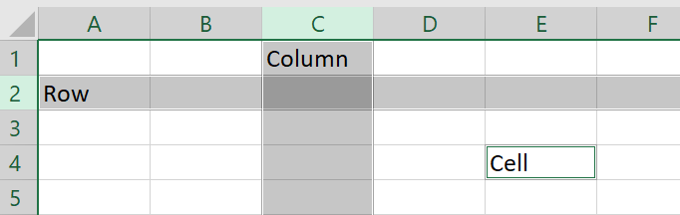
Slide 3
A spreadsheet page is organised into a grid made up of lots of rectangles called “cells”
These cells are organised horizontally into rows and vertically into columns
In the picture above, the “C” column and row “2” are both highlighted.
When we name a cell, we always mention the column, then the row., So we can say that the word “Cell” was written in cell “E4”.

Slide 8
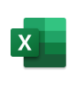
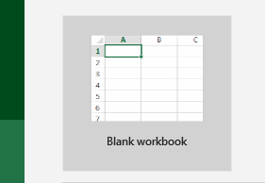
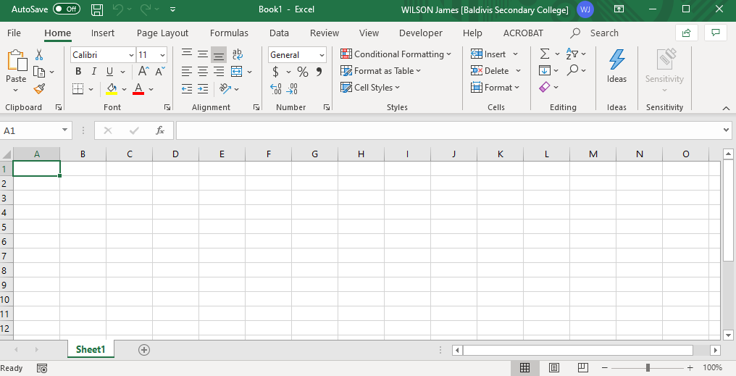
Slide 4
Open Excel – it’s time to try it together
Open excel – click on the “Excel” logo. It should be somewhere in your Windows menu or you can type “Excel” into your Search toolba,. Once Excel loads, double click onto “blank workbook”
You should now have a blank spreadsheet
4

Slide 9
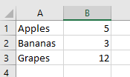
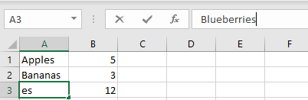
Let’s enter some data
Click on cell “A1 and type “Apples” then press enter. It should take you down to cell A2. Type “Bananas” and press enter. Then type “Grapes” and press enter again. Now click on cell B1 and type 5, press enter, type 3, press enter and type 12. Your table should look like this:
If you make a mistake, click on the cell that has the mistake and type the changes into the formula bar. Try using the formula bar to change Grapes to Blueberries so that the spreadsheet now looks like this:

Slide 10
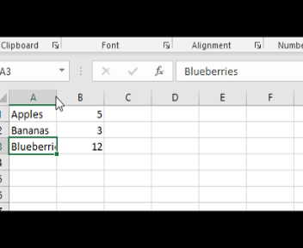
Resize the column
You will notice that the word Blueberries doesn’t fit into the column correctly. You can resize the column by grabbing the line between column A and B and dragging the column to the size that you want. (you can do the same with rows).

Slide 11
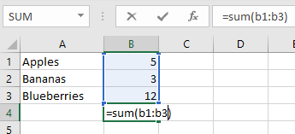
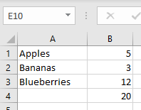
Now we are going to add a formula.
Formulas can be used to do calculations for us.
Click on the cell “b4”and enter the following
=sum(b1:b3)
This will add all the values in cells in the region starting from cell b1 and continuing to cell b3
Now change the number of bananas to 7 and the number of apples to 9, you will see that the spreadsheet immediately recalculates the total for you.

Slide 12
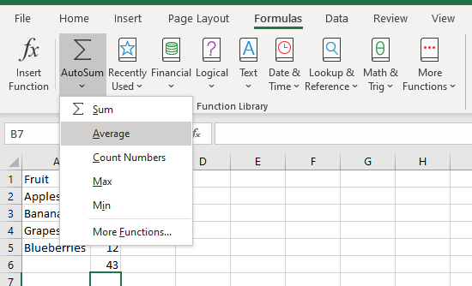
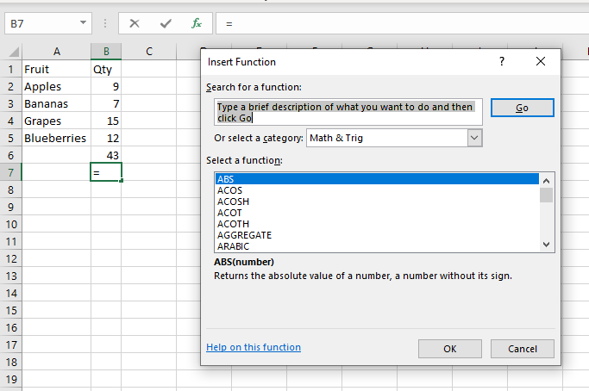
Other formulas
There are many formulas in excel that you can use.
To find them all, click on a cell and go to the Formula’s tab. Here they are grouped into categories.
You can also click the fx button on the formula bar and get a list of all the formulas.

Slide 13
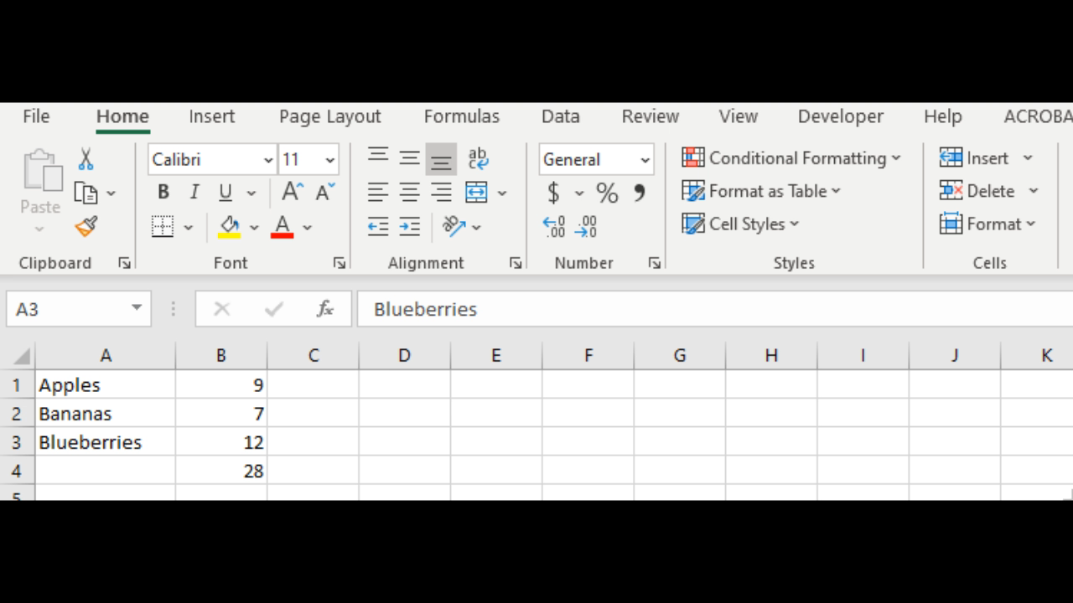
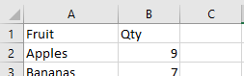
Add an extra row of fruit into our table
I am going to add Grapes back into the table just above the Blueberries. Click on row number 3 which highlights the entire row. Then click on the “insert cells” icon on the “Home” section of the ribbon and add a new row. Now type in “Grapes” in the new cell add 15 as the quantity.
You can also add and remove columns using the same process.
Notice that formula we added before automatically recalculates the new total with the new row included.
Use this method to add a row above your table so you can add headings to your column such as “Fruit” and “Quantity”

Slide 14
Task – MS Excel Spreadsheet
Login to Connect and you will find in Content that there has been a MS Excel Spreadsheet that I have started for you.
You will need to complete it by:
Determining how much food to buy
Researching the prices of food for the week
Using MS Excel to calculate how much money needs to be spent
In the same area, you will also find the recipes that have been chosen by me for you to work out other information like nutritional value and cooking time as well as any other information you feel is important.

